Slide 1
Code Fury
Presented by
Runtime Terrors

Slide 2
Group Members
Astha Padhi
Dishani Basak
Anirban Khara
Harshit Kumar
Geetha Manogna Goddu
Jhanvi Garg
Korada Venkatesh
Kishore TM
Dusa Vamshikrishna
Back
Hittej Rajpurohit
Next

Slide 3
Table of Contents
01
About the Application
02
Roles Involved
03
Features of the Application
Hardware/ Software Requirements
04
UI Snapshots
05
06
Key Learning

Slide 4
About the Application
A web-based application called the E-Asset Management system is used to maintain track of a variety of assets that can be lent out as well as their availability, present location, current borrower, and asset history.
Assets include computers, books, mobile phones, and other gadgets. The system can be expanded to handle the management of more asset kinds.

Slide 5
About the Application
The administrator is in charge of managing assets.
When necessary, assets are added to the system.
Users can search for assets, and if any are found, they can borrow those same assets.
The assets must be returned within a given time frame; the time frame varies depending on the type of asset.
If asset is not returned on time a fine should be imposed on the borrower, and the system should not lend any more assets to the borrower for a specified number of days.

Slide 6
Roles involved in the application
Administrator
Borrowers (Employees of the company)

Slide 7
Features of the Application
Employee Home Page:
Home Page- As the database already contains the details of the admin, it has an option for new employees to register and existing employees to login
After Registering, employees can login. Here, the information about the employee is displayed, the list of borrowed items, their details and due dates are displayed
Messages sent by the admin can also be displayed.

Slide 8
Features of the Application
Admin Home Page
User Information like name, email, last logged-in date, time, etc,. Are displayed
In this page you can add asser
Here, you can find a link to view overdue assets

Slide 9
Features of the Application
In our application, we used RDBMS server to store the data.
All the data is normalized
Application is object oriented and extensible, so new features can be added easily
Exception handling is implemented
This web application is based on MVC design pattern
Layered architecture with loose coupling is used

Slide 10
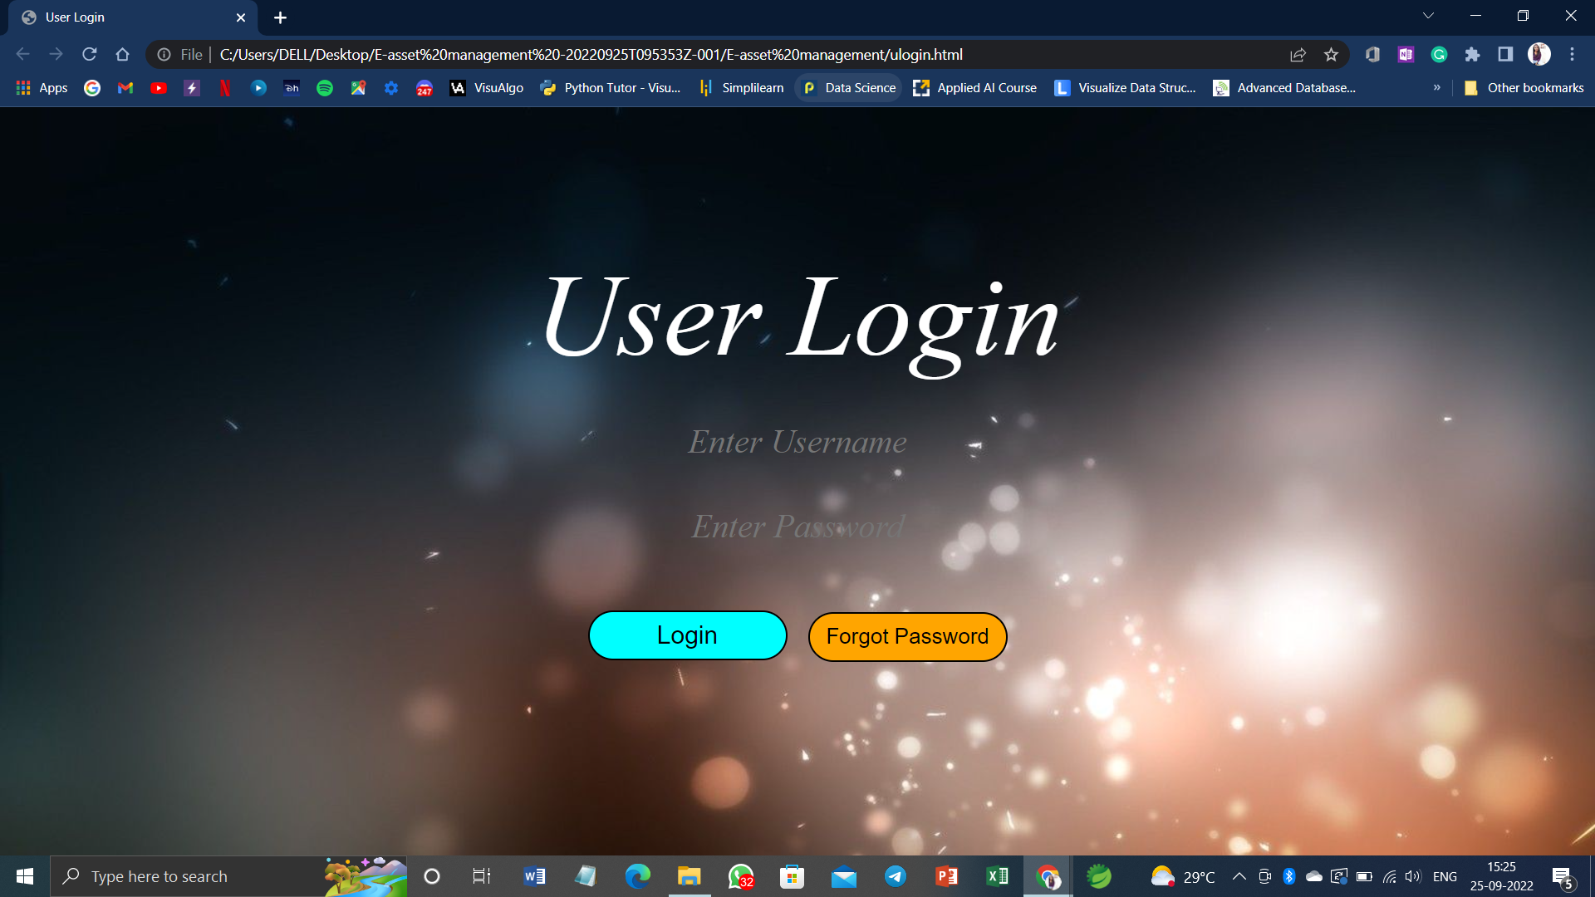
UI Snapshots

Slide 11
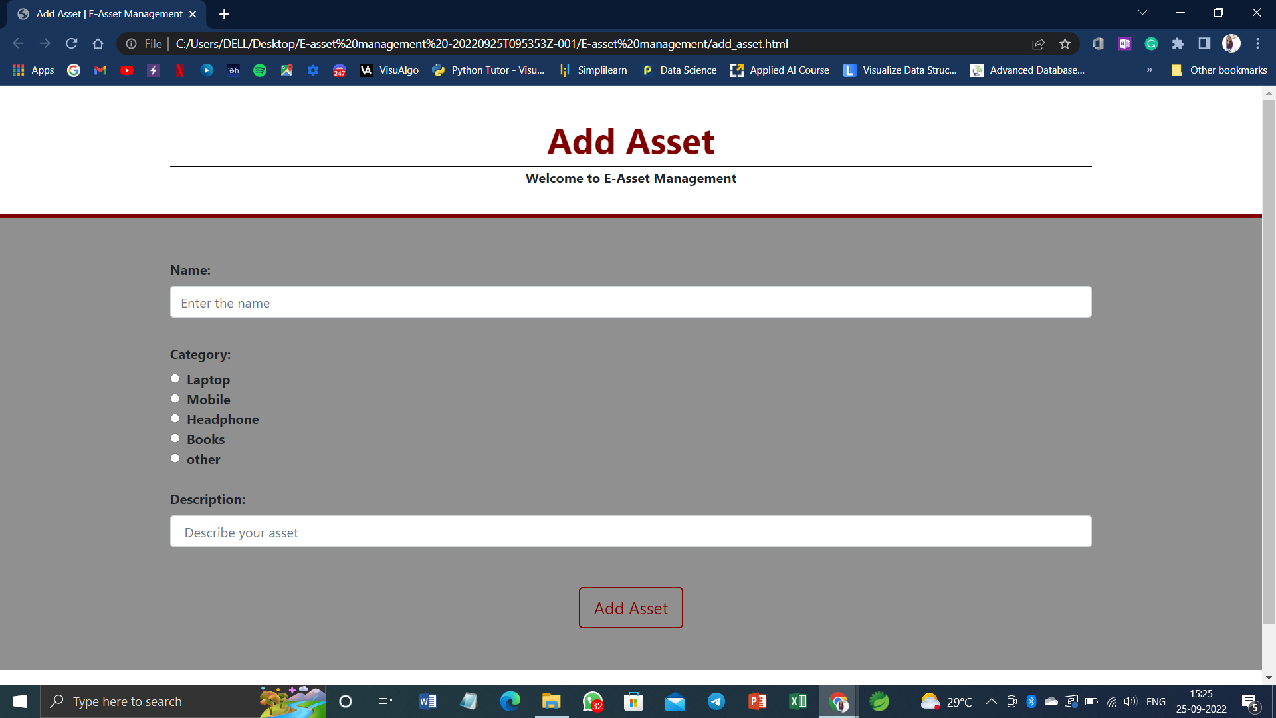
UI Snapshots

Slide 12
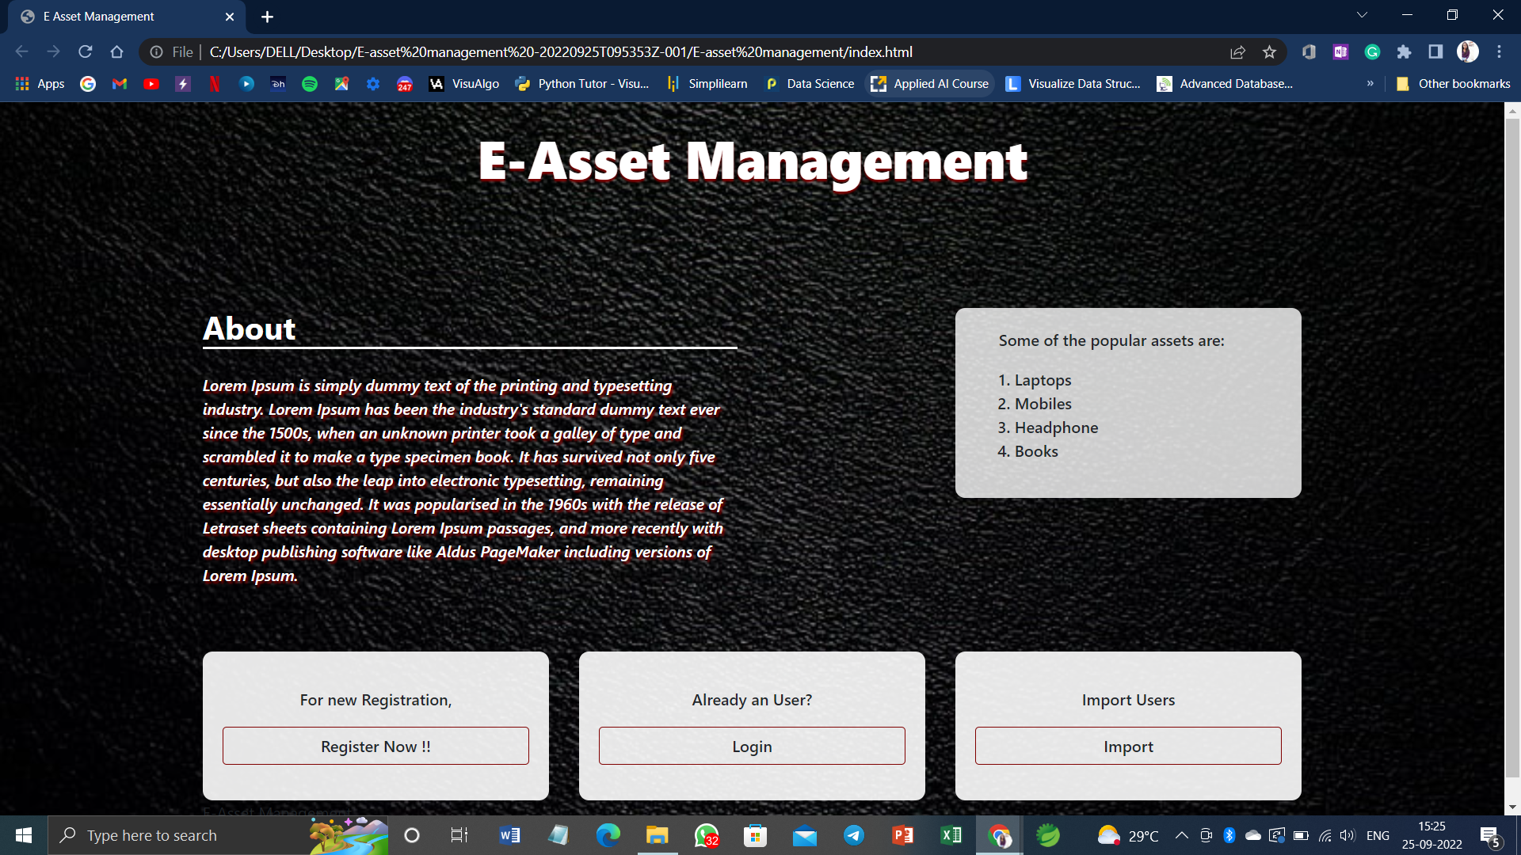
UI Snapshots

Slide 13
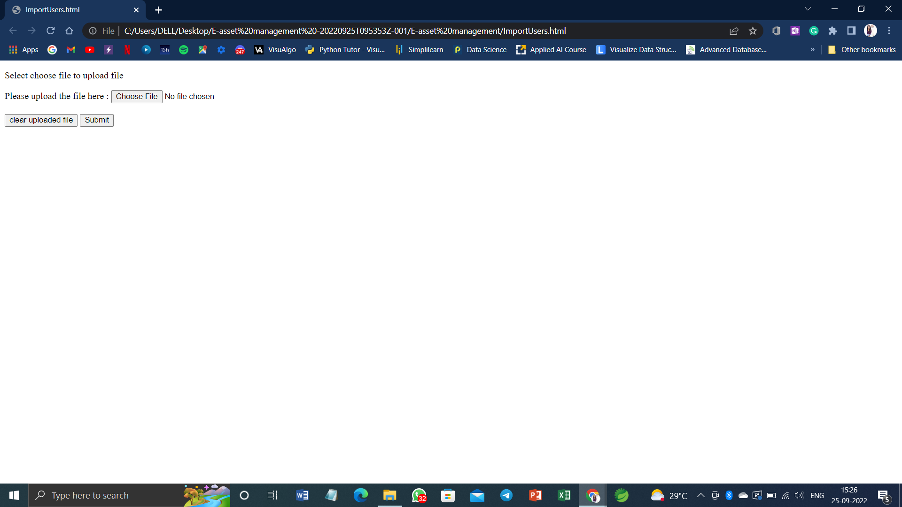
UI Snapshots

Slide 14
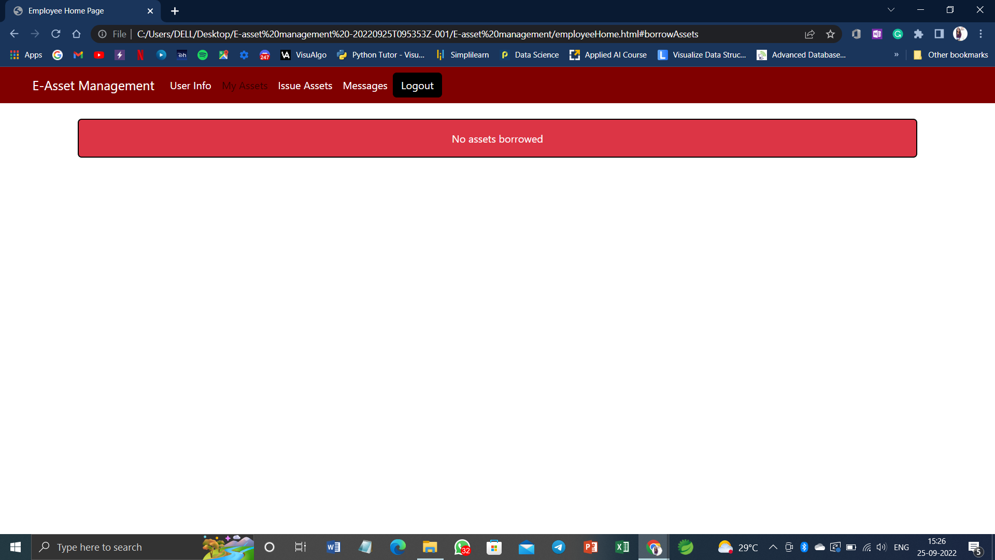
UI Snapshots

Slide 15
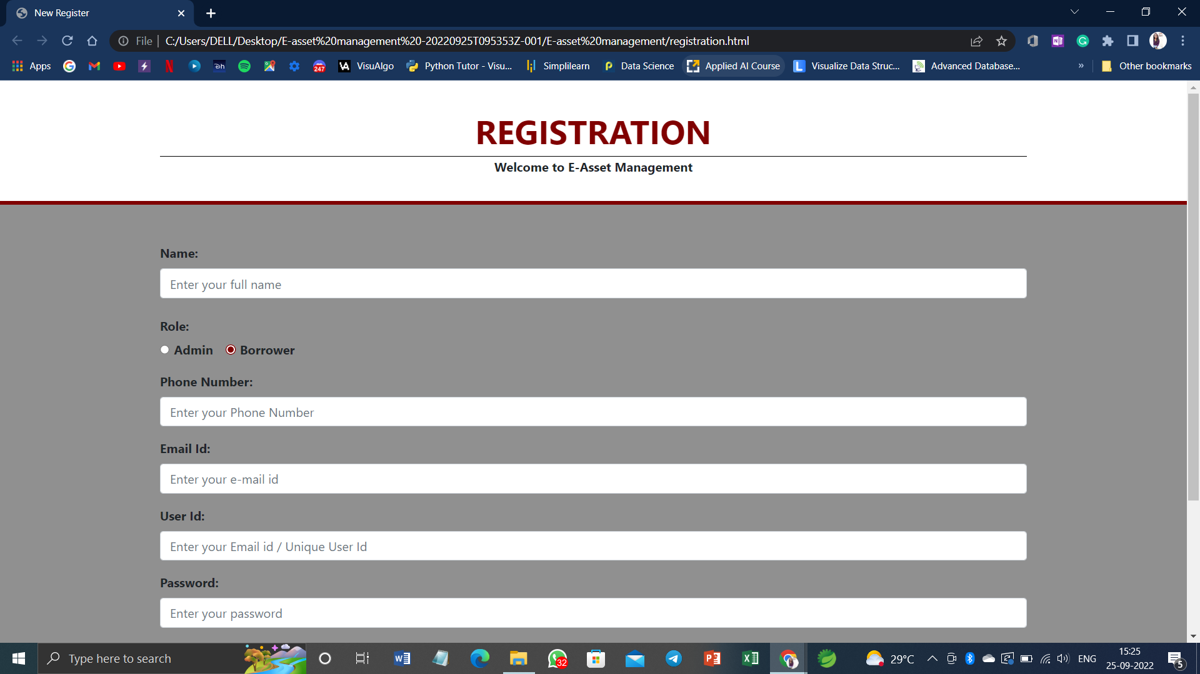
UI Snapshots

Slide 16
Hardware and Software Requirements

Slide 17
Key Learnings

Slide 18
Thank You!!
-Team Runtime Terrors

